Slide 1

USGS Earthquake Data API: A Comprehensive Flask Application for Data Retrieval and Analysis
TEAM MEMBERS
Harjit Brar
Naini Singh
Tarenjeet Kaur

Slide 2
Project Summary
This project leverages Python to develop a Flask-based web application for accessing and visualizing USGS earthquake data stored in a MongoDB Atlas database. The application provides API endpoints to fetch all earthquake records, retrieve details of a specific earthquake by its unique ID, and filter earthquakes within a specified date range. Additionally, the project includes the creation of a website to display interactive charts and visualizations of the earthquake data, enhancing user experience and data insights. This end-to-end solution integrates Python, Flask, and MongoDB for backend development, with plans for a front-end interface for data visualization, fulfilling all project requirements for dynamic, accessible, and visually appealing earthquake data representation.

Slide 3
Team Introduction alongside their roles of this project:
Harjit Brar (Developer & Business Analyst):
Built the backend and frontend of the web application. Implemented data storage in a cloud-hosted database and visualization processes. Deployed the web application to Render for public access.(Host website)
Naini Singh (Data Analyst & Developer): 22-years old, educational qualification in B.Sc Geology, and Postgraduate Diploma in GIS Cartographic Specialist. Aiming to explore data-related proficient career, and flexibility of learning.
Tarenjeet Kaur (Project Manager):

Slide 4
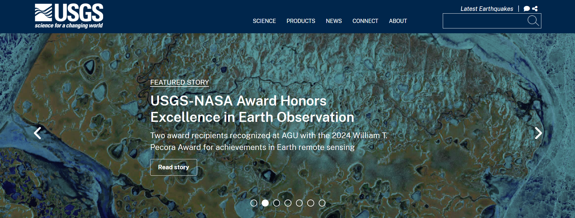
Data Acquisition
The USGS dataset is highly user-friendly due to its robust and well-documented API, which provides earthquake data in a standardized GeoJSON format. This format is easy to parse and widely compatible with various programming environments, including Python. The API offers flexible querying options, allowing users to filter data based on parameters such as time range, magnitude, and location, ensuring that only relevant data is retrieved. It also provides real-time updates and includes rich metadata, such as magnitude, location, depth, and timestamps, making it ideal for detailed analysis and visualization. Additionally, the API's straightforward integration capabilities enable seamless use in web applications, Python scripts, and other tools, making it a powerful resource for developers and researchers.

Slide 5
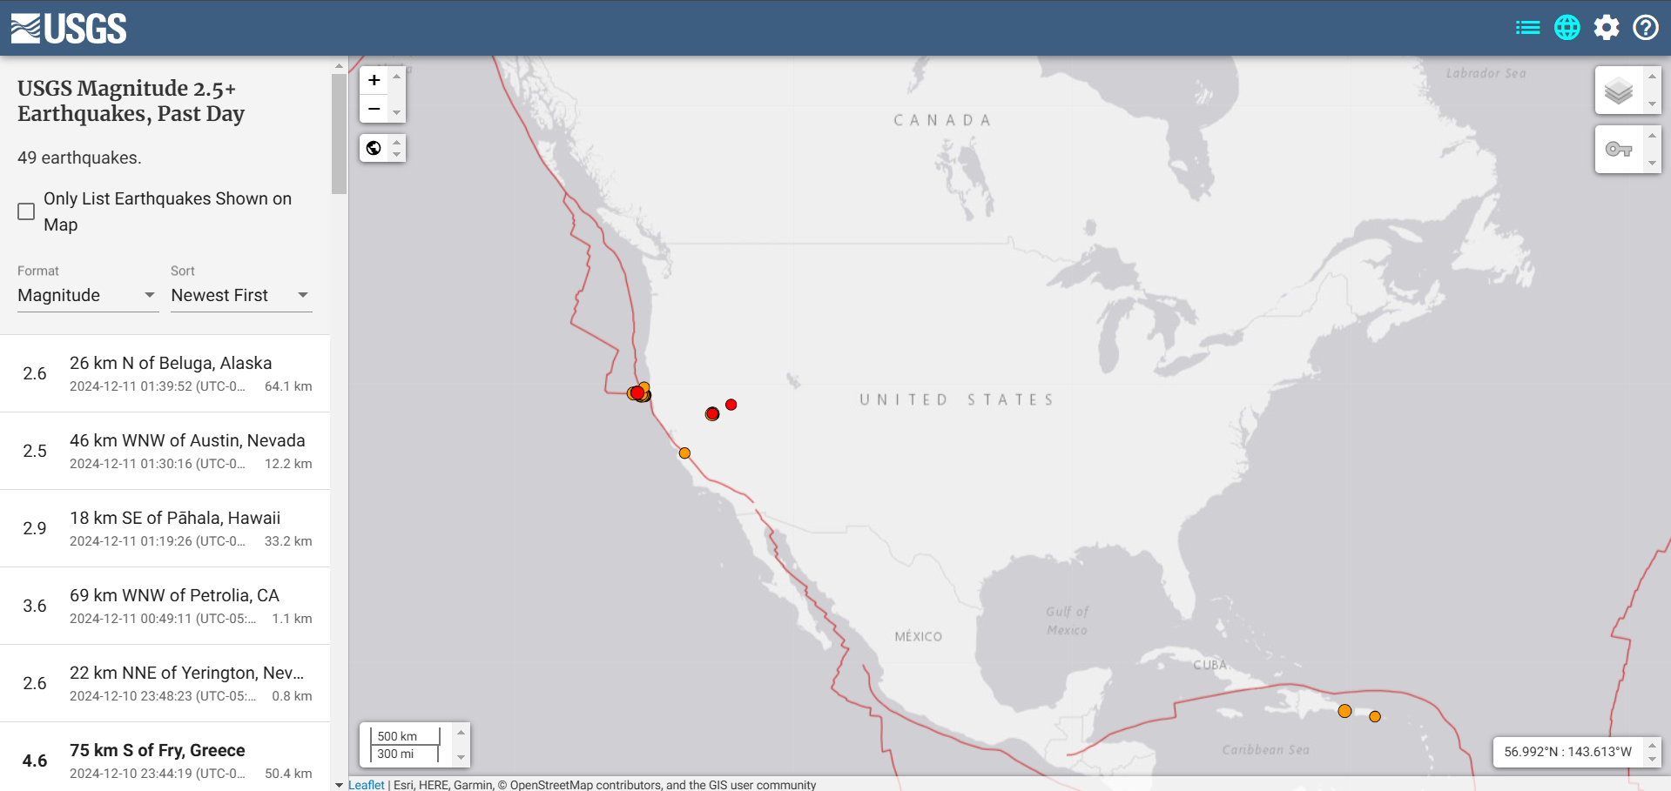
USGS Earthquake Data
Earthquake data is an ideal choice for our project due to its dynamic and live nature, aligning perfectly with our project requirements. The USGS earthquake dataset provides real-time updates, making it suitable for building applications that require current and actionable information. This live data allows us to create an interactive web app where users can fetch and analyze earthquake events based on specific IDs or within a date range. By leveraging Python and Flask, we can process and serve this live data efficiently, while integrating data visualization features ensures meaningful insights. The availability of live earthquake data not only enhances the usability of our application but also demonstrates the power of integrating real-time information into modern web-based solutions.

Slide 6
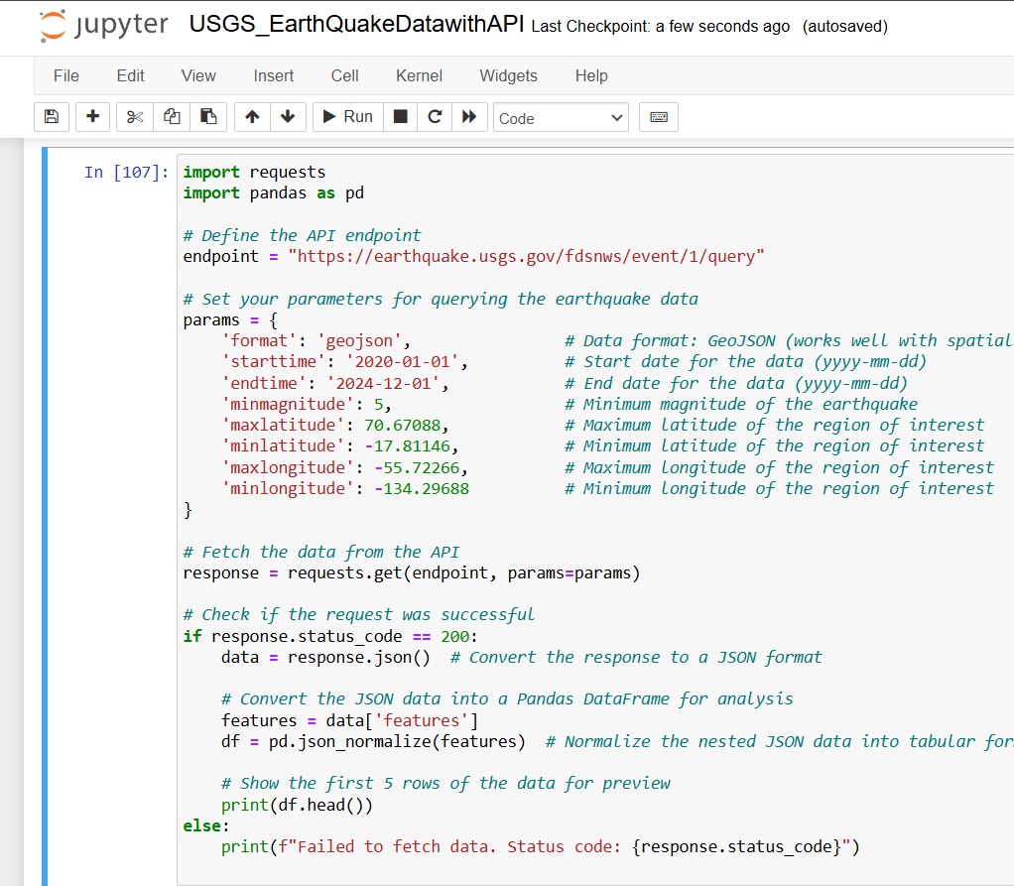
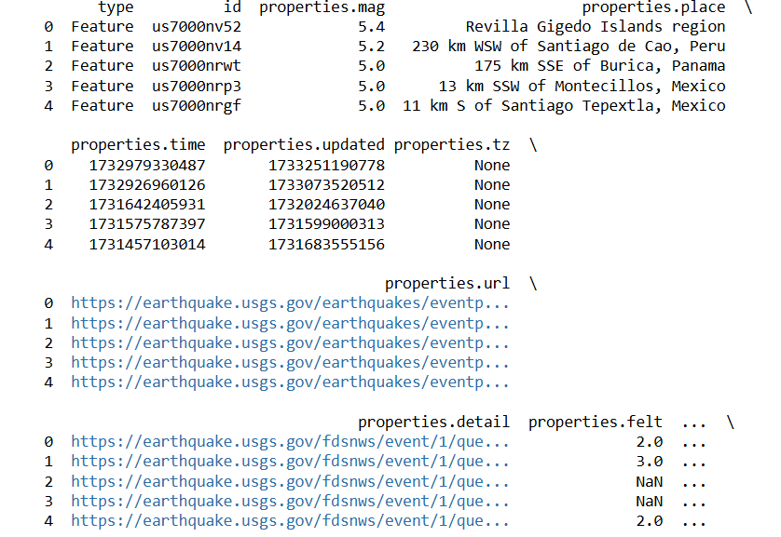
Python Code For Acquiring Earthquake Data Manually from USGS Live Dataset.
Output:

Slide 7
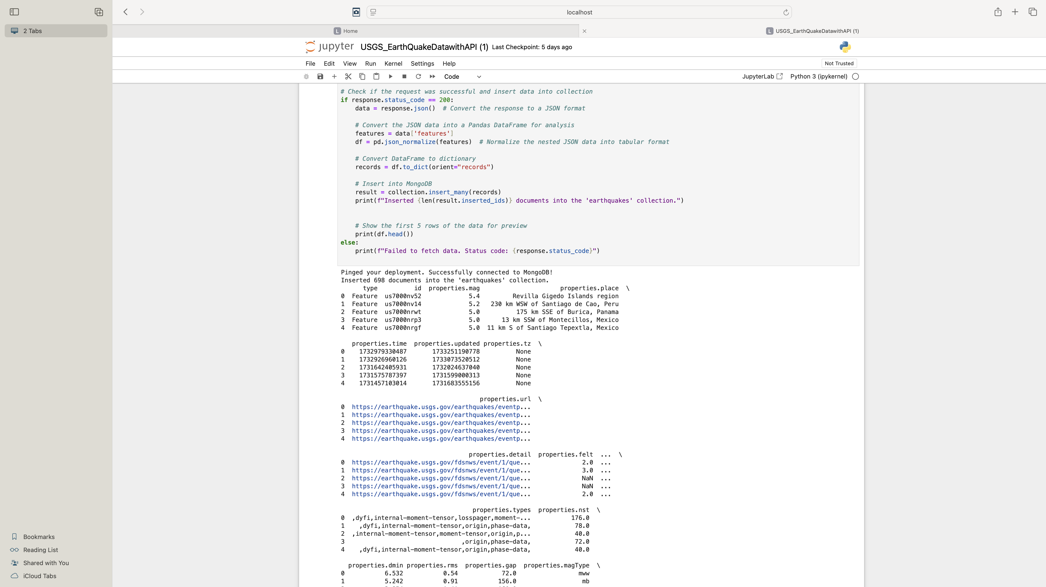
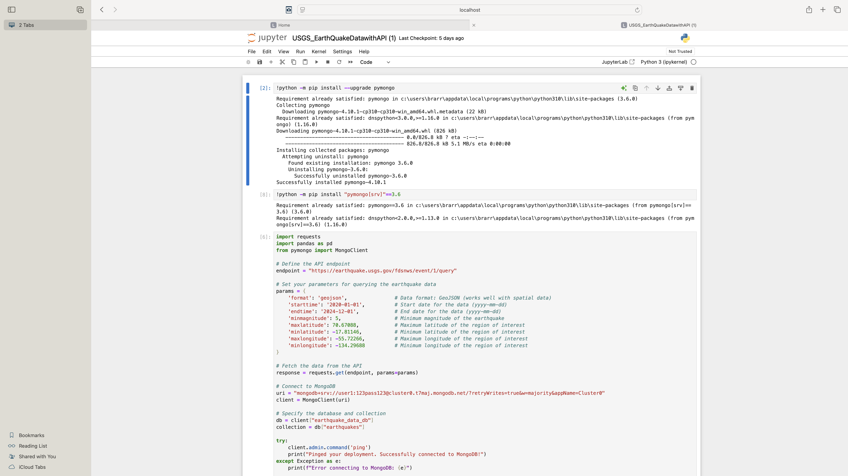
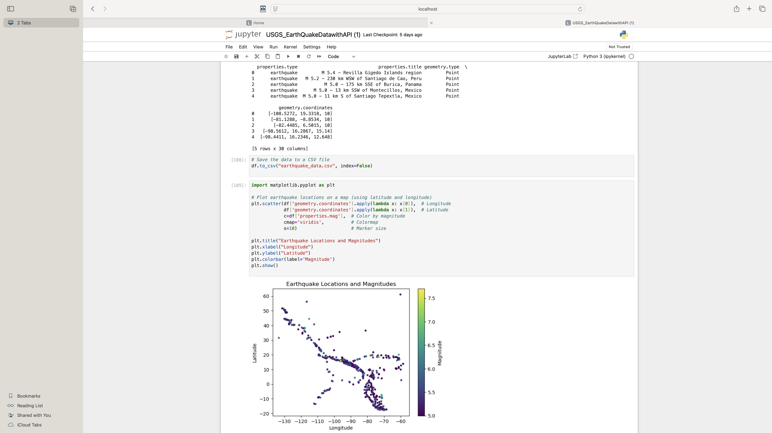

Slide 8
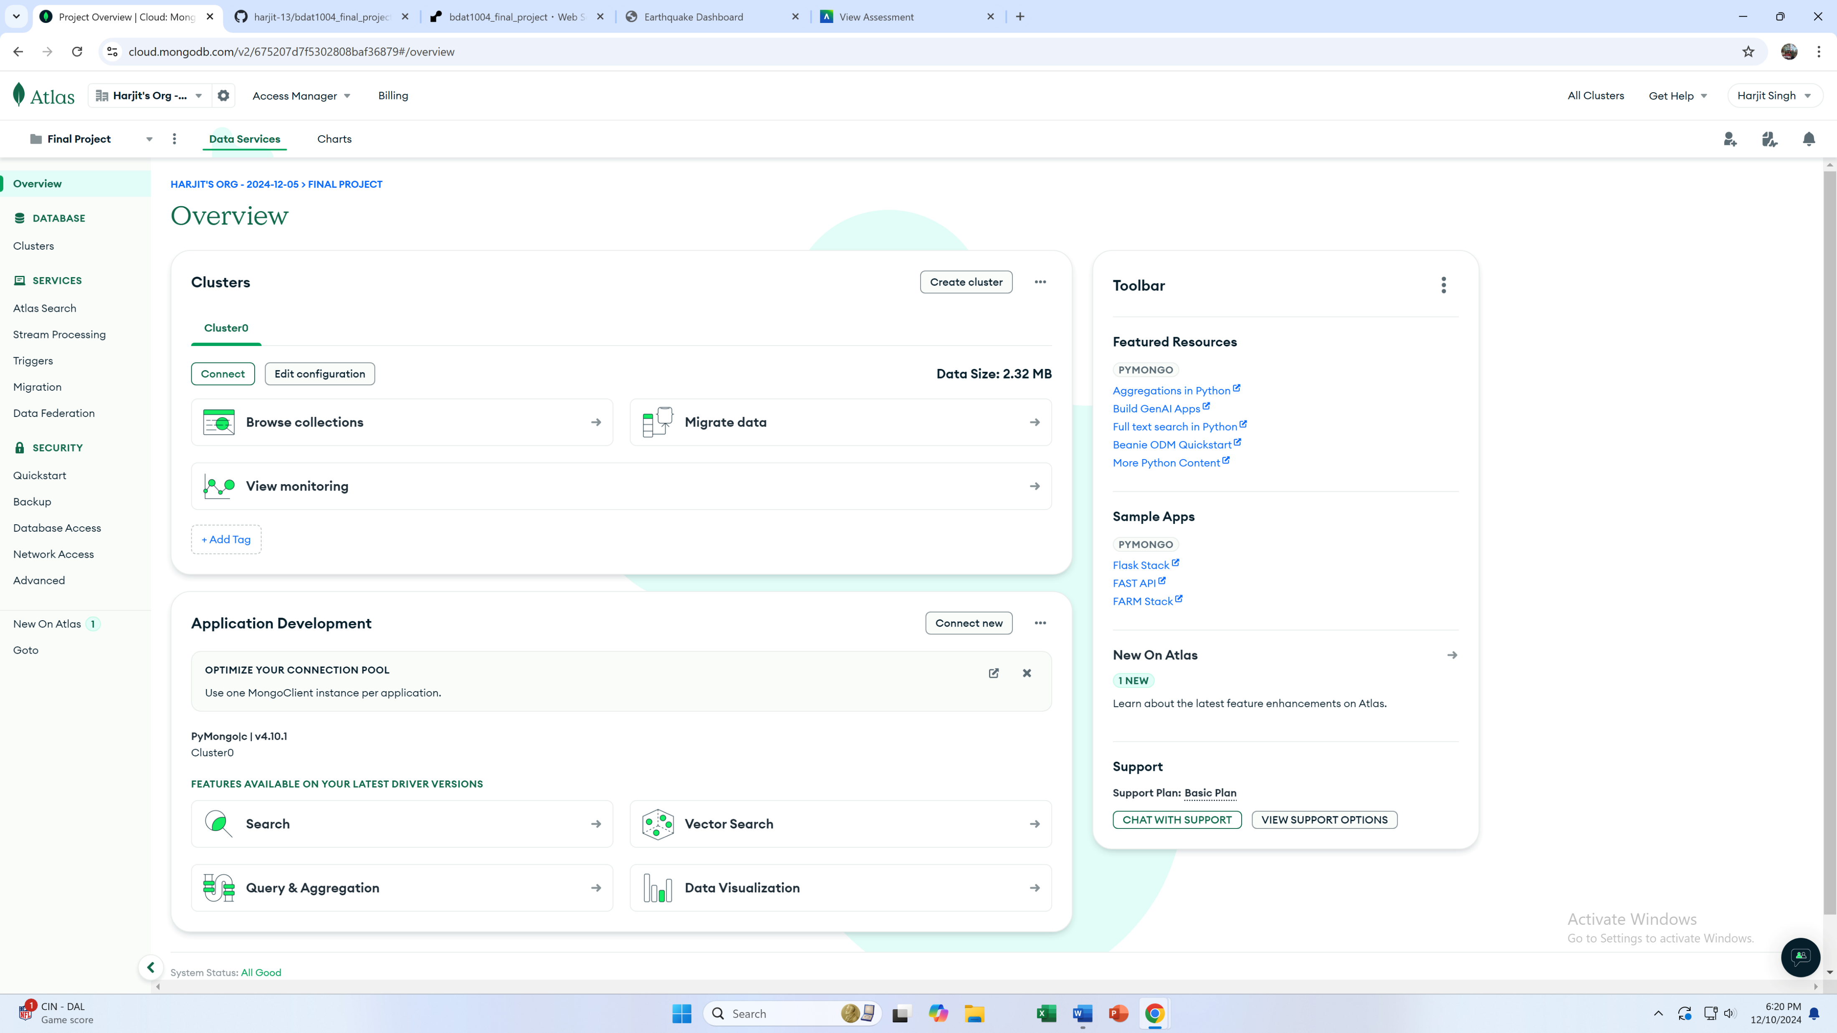
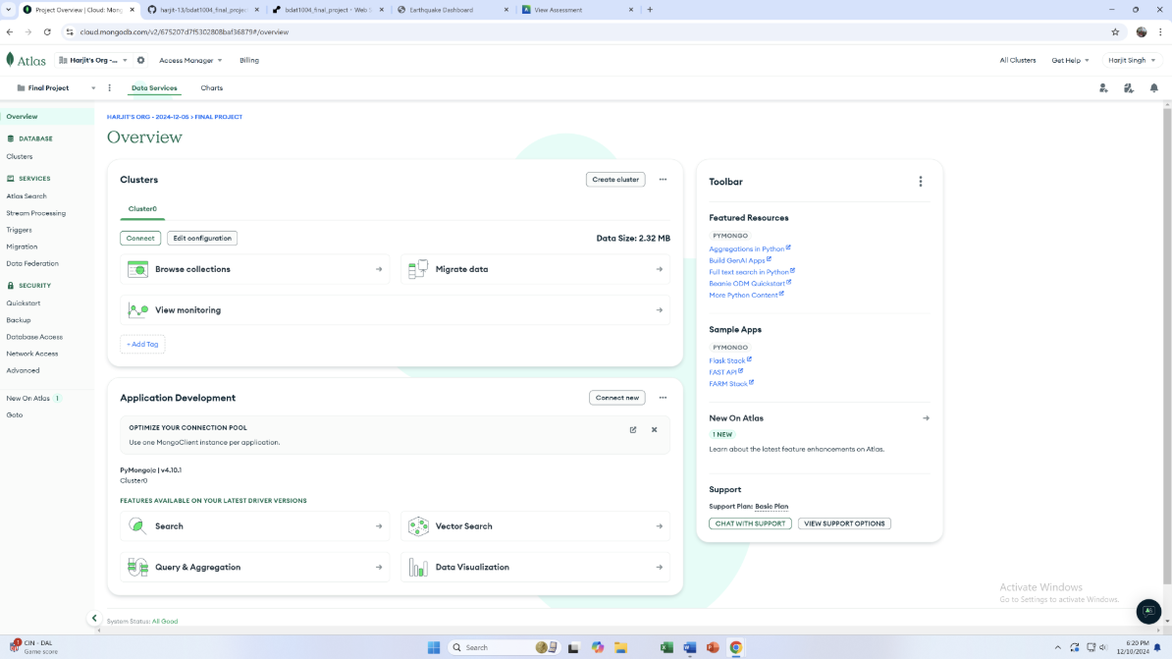
Using MongoDB (NoSQL) Database Design.
To support our project's data storage and retrieval needs, we established a connection to MongoDB, a NoSQL database, and uploaded earthquake data from the USGS API. MongoDB's flexible schema and document-oriented structure make it an excellent choice for handling dynamic and semi-structured datasets like the USGS earthquake data. By using Python and MongoDB's driver, PyMongo, we were able to efficiently fetch, process, and store real-time earthquake data directly from the API. MongoDB's scalability and ability to handle large datasets with varying attributes ensure that our application can manage the live and continuously updating nature of earthquake data. This approach enables seamless querying and serves as a robust backend for building interactive features in our web app.

Slide 9
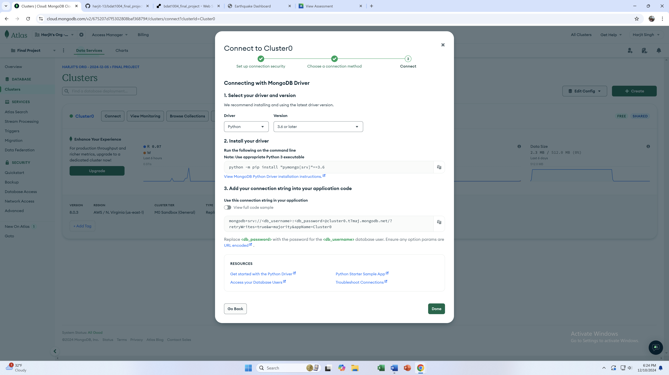

Slide 10
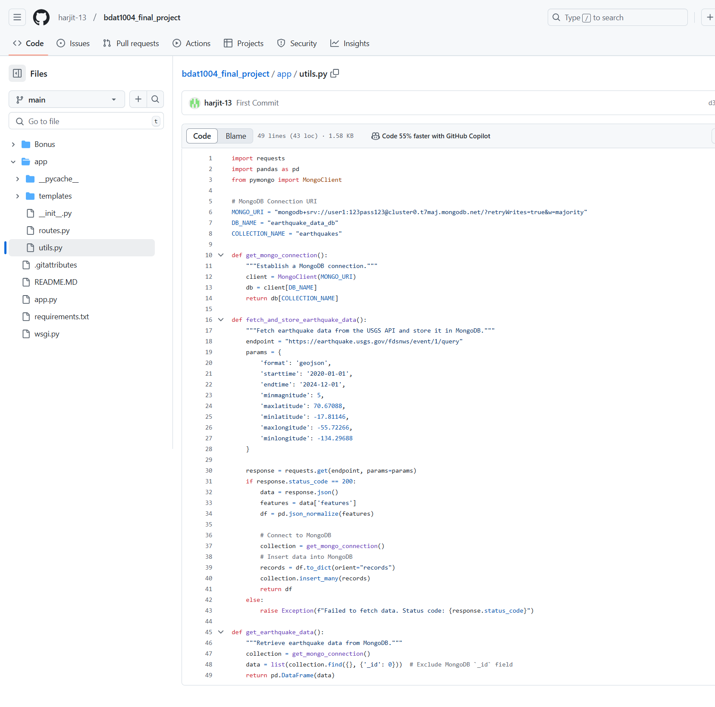
Connecting Earthquake Data to Cloud-Database MongoDB (NoSQL)
The code available on GitHub is designed to fetch earthquake data from the USGS API and store it in a cloud-based NoSQL database, specifically MongoDB. Using Python, the script connects to the USGS API to retrieve live earthquake data in JSON format, processes the data to ensure compatibility with the database schema, and stores it in MongoDB. The code utilizes the requests library to make API calls and PyMongo to interact with MongoDB. It efficiently handles data insertion into the database, ensuring real-time updates. This solution enables scalable, accessible storage of earthquake data that can be easily queried and integrated into web applications for analysis or visualization.

Slide 11
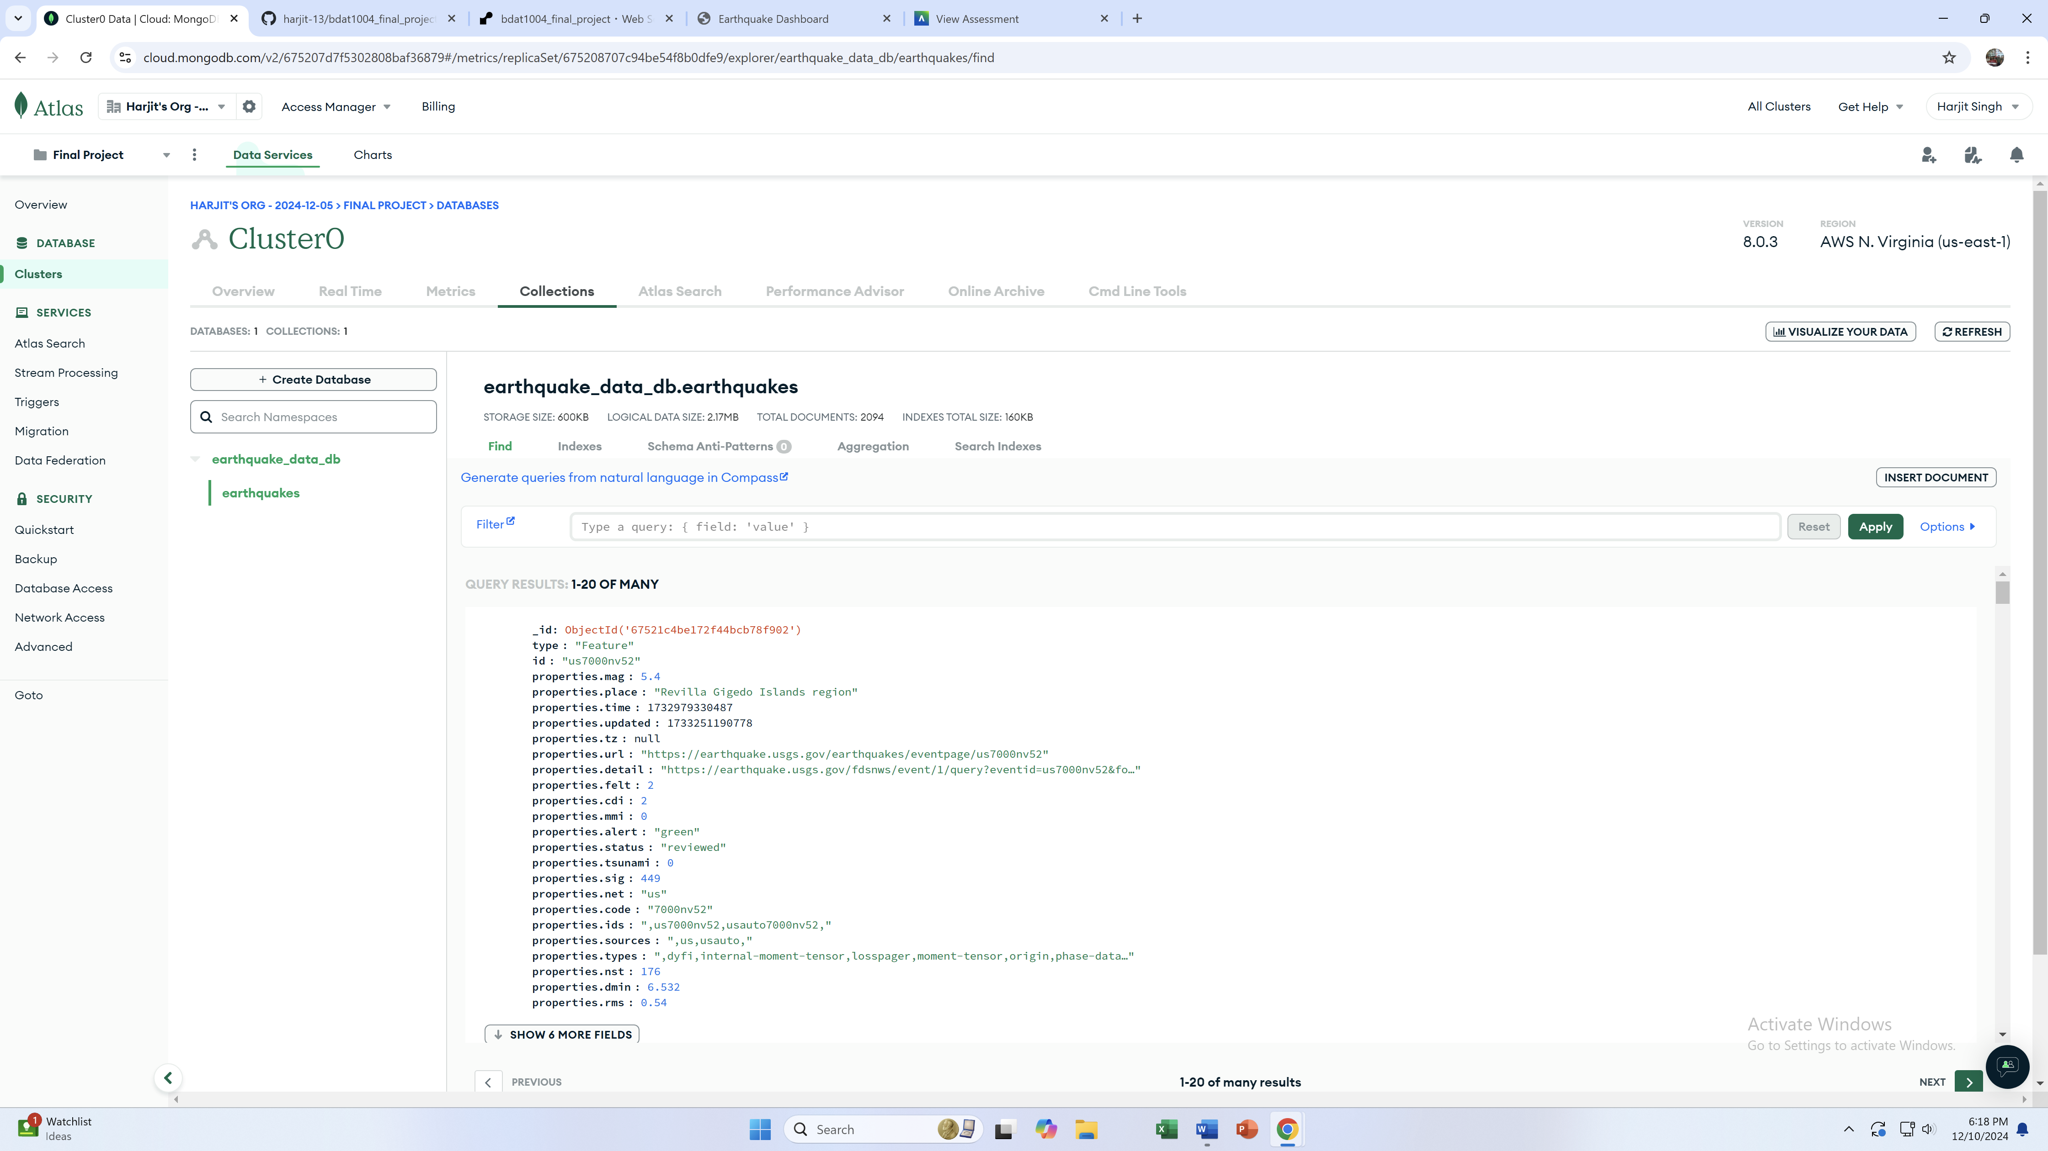
Earthquake Database in MongoDB stored.

Slide 12
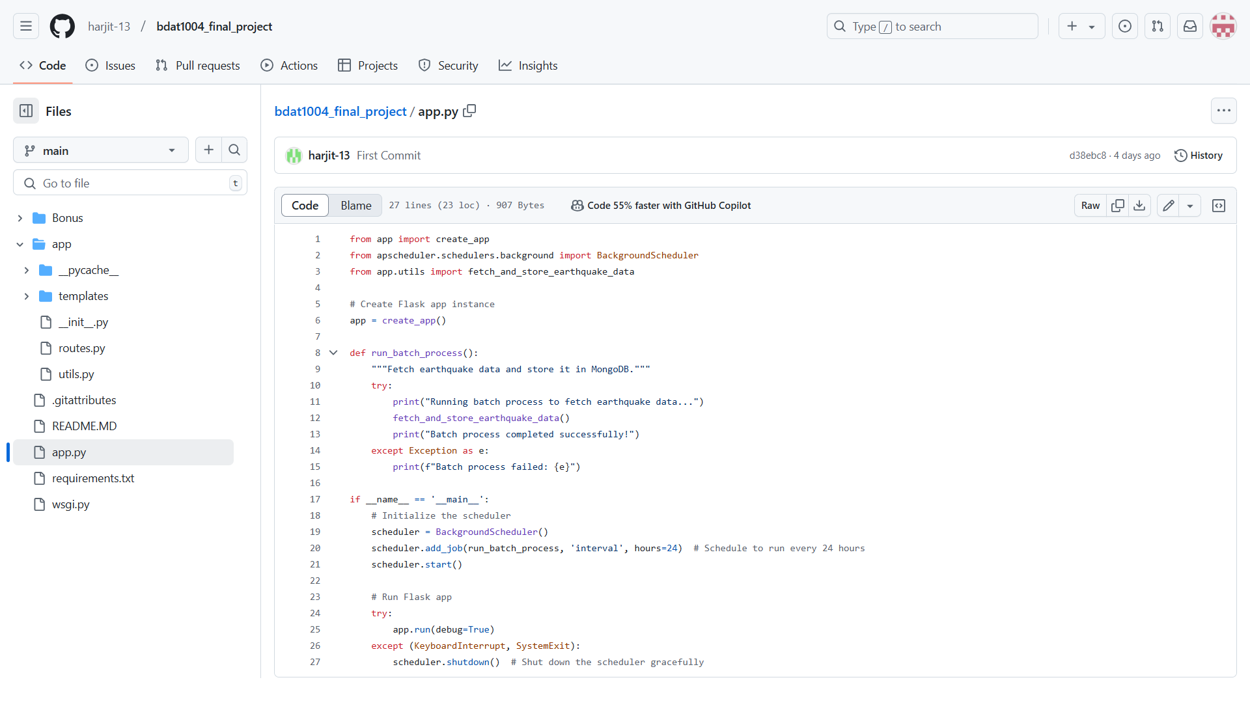
Batch Process (Flowchart of 24 hr automation) using APSchedular
This code sets up a Flask web application that fetches and stores earthquake data from the USGS API into a MongoDB database using a scheduled batch process. The run_batch_process() function retrieves the latest earthquake data and stores it in MongoDB, and this process is executed every 24 hours using the BackgroundScheduler from the apscheduler library. The scheduler ensures that the database is updated regularly with new data while the Flask app remains responsive for other tasks. The app gracefully handles shutdown events, ensuring that any ongoing tasks are completed before the system stops. This setup automates the data fetching and storing process, maintaining up-to-date earthquake records in the database.

Slide 13
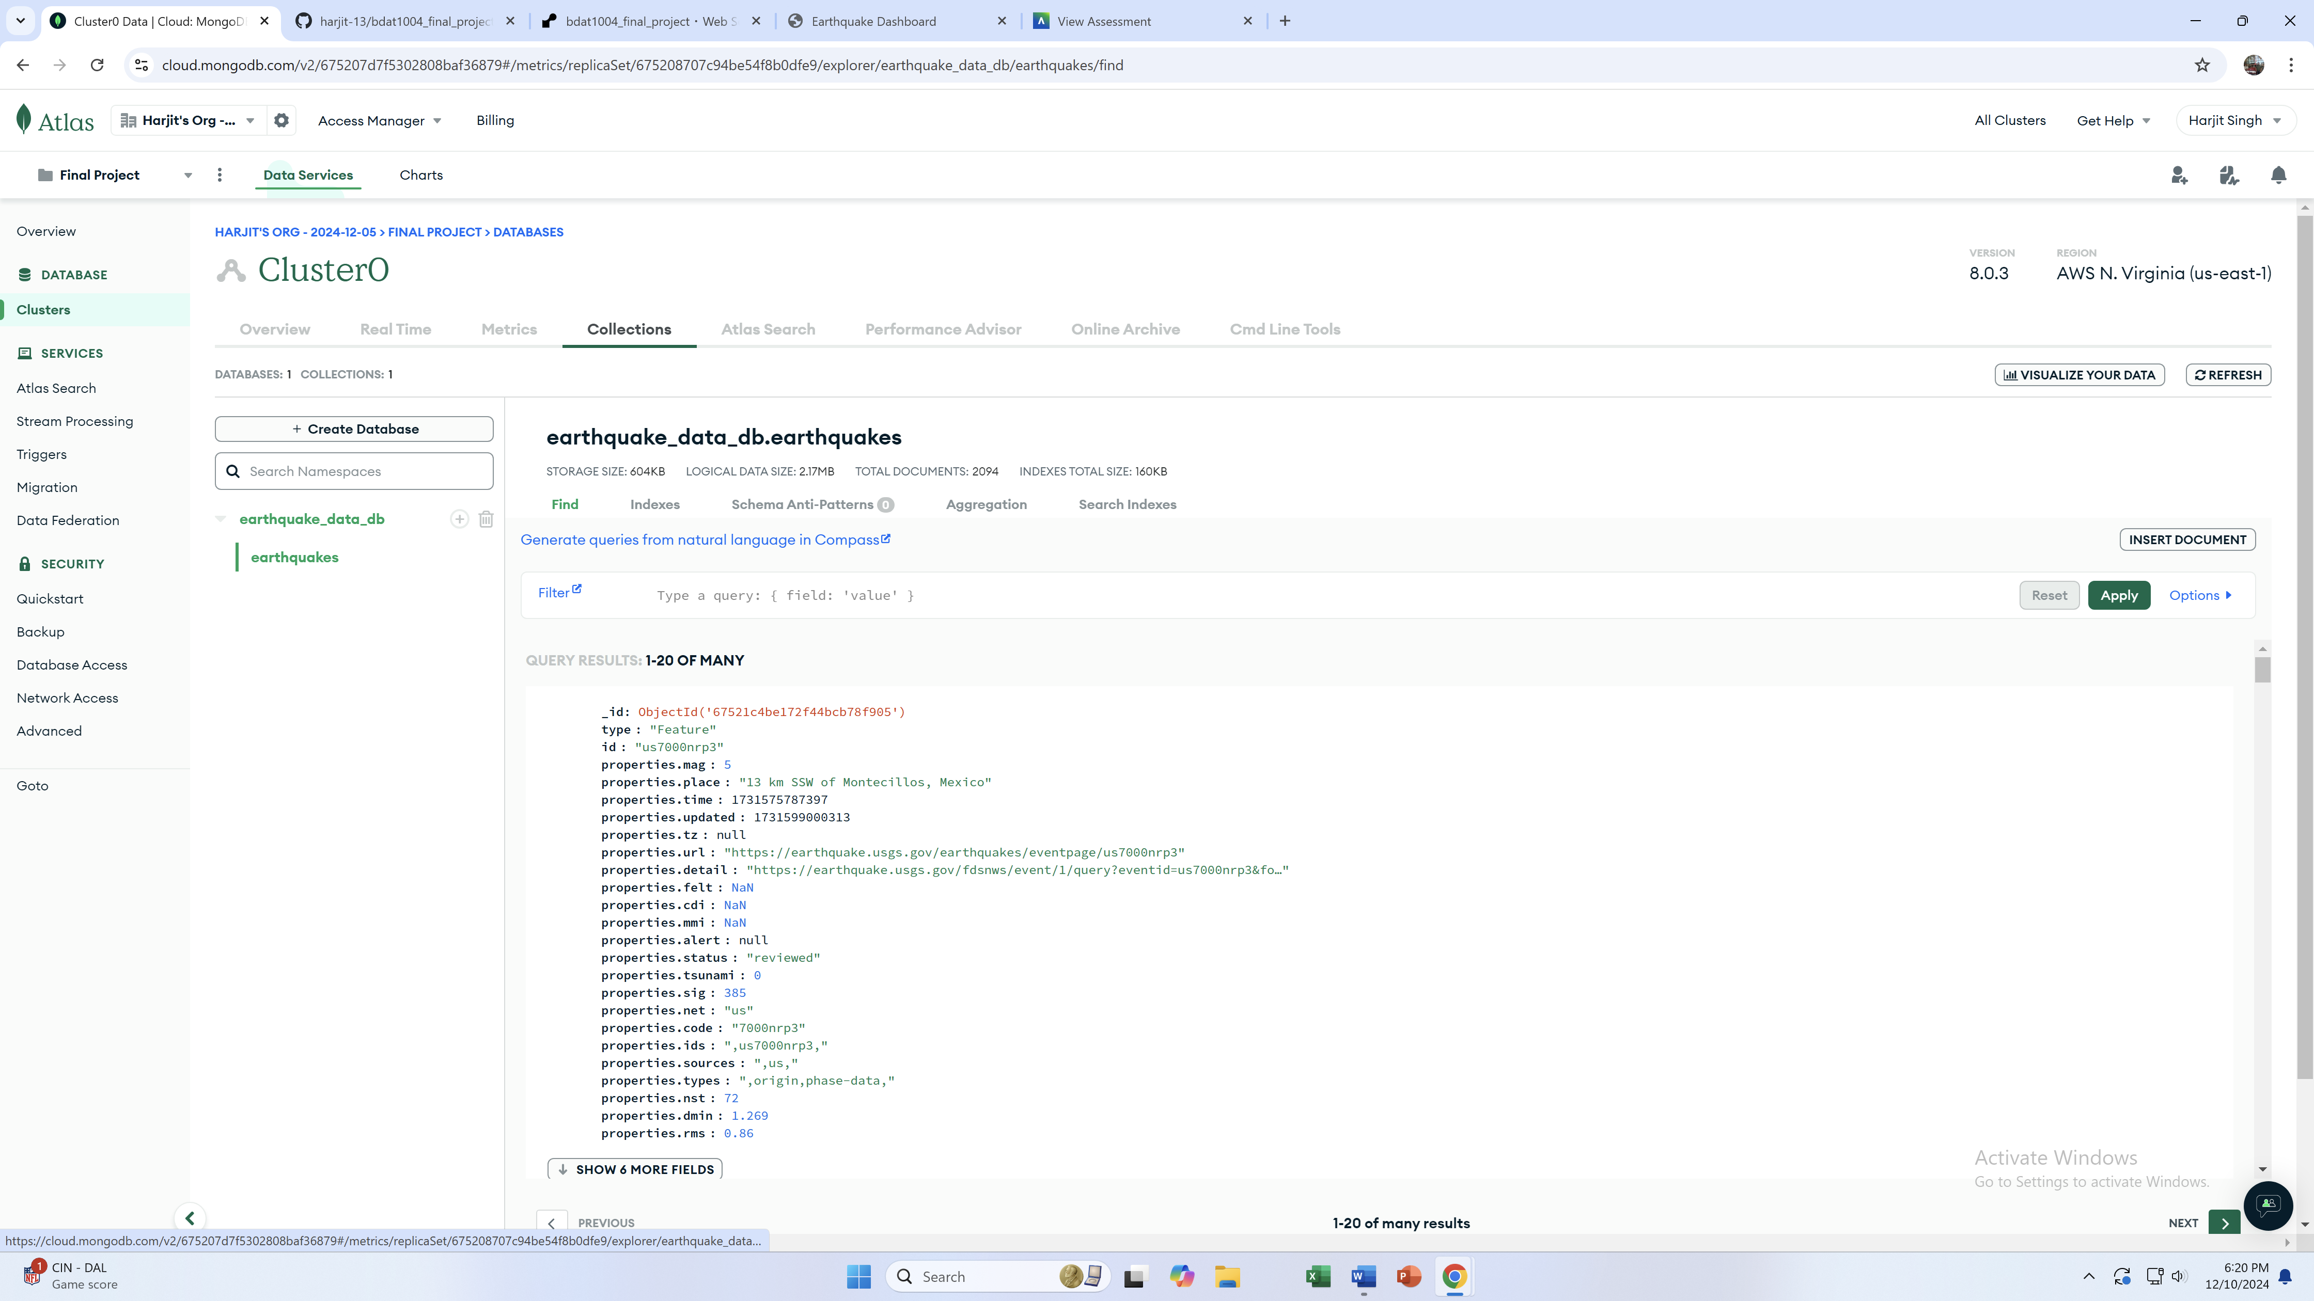
New Data in the database after using APSchedular that updates past 24 hours data.

Slide 14
New Data in the database after using APSchedular that updates past 24 hours data.

Slide 15
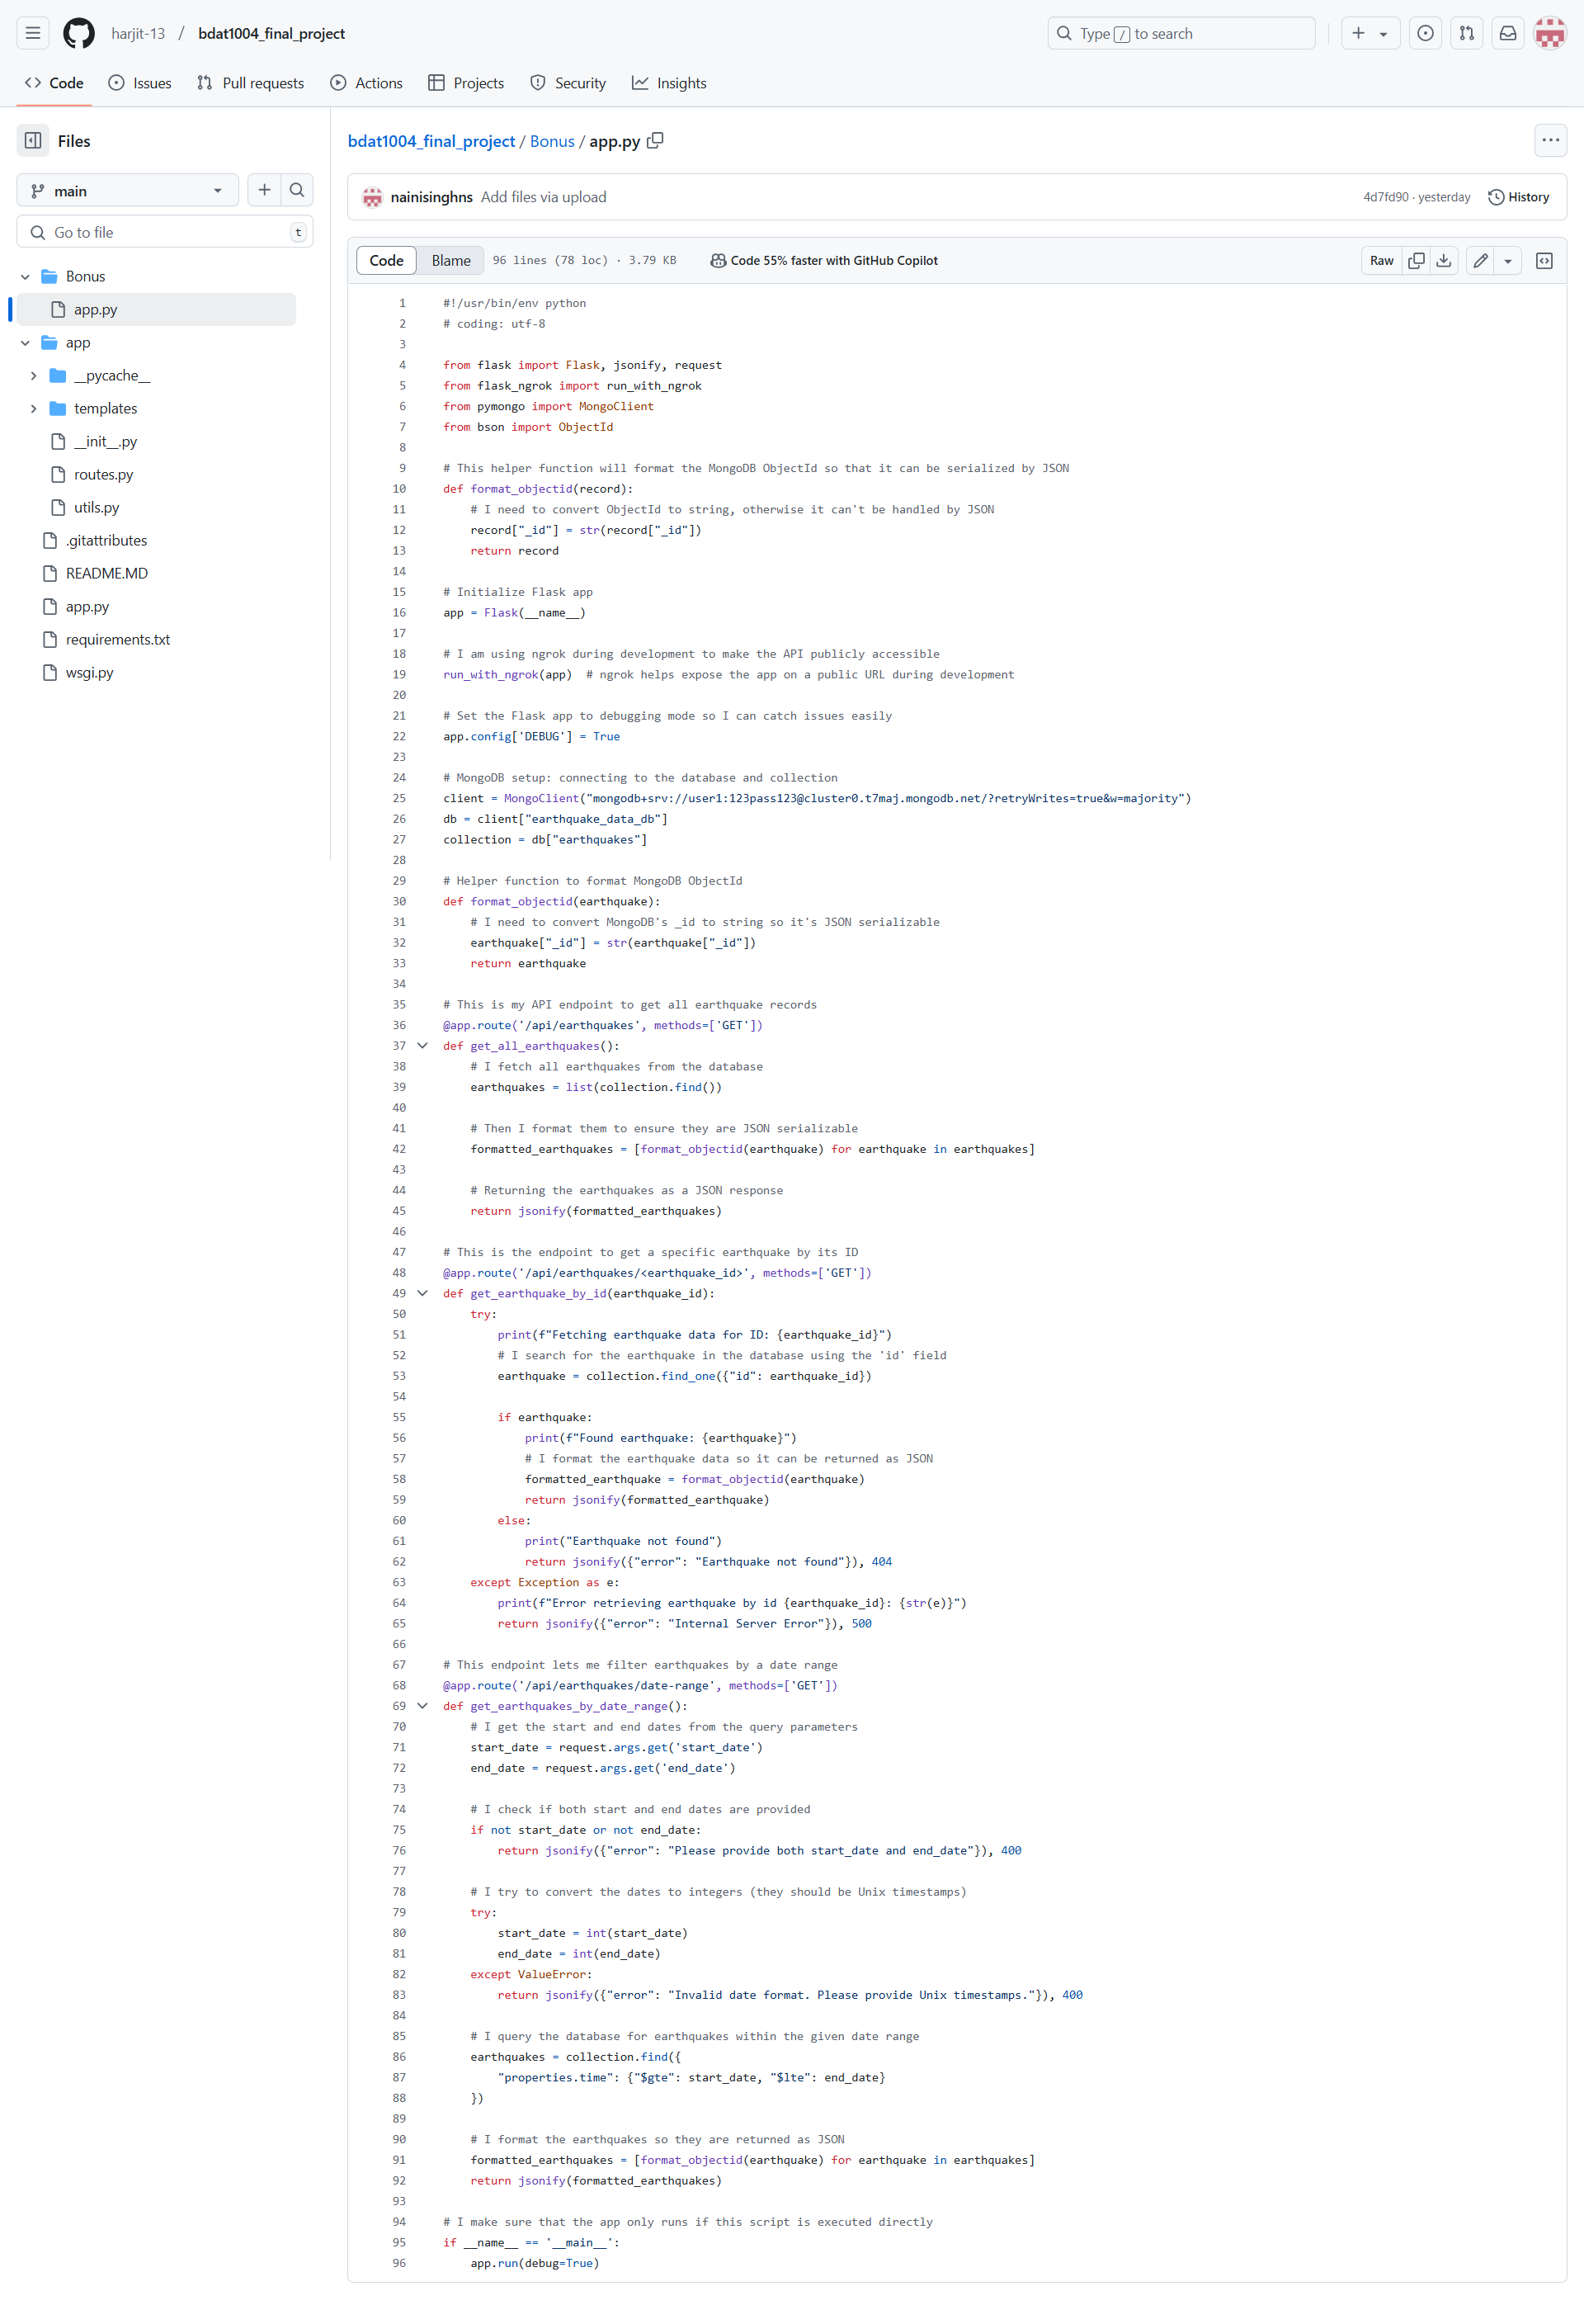
API Development using Flask (fetches all records, by ID, and with filter like start and end date.
This Python Flask application provides an API to fetch and manage earthquake data stored in a MongoDB database. It includes three key endpoints: one to retrieve all earthquake records, another to fetch a specific earthquake by its ID, and a third to filter earthquakes by a specified date range. The application uses a helper function to format MongoDB's ObjectId to a string, making it compatible with JSON serialization. It also utilizes ngrok for public URL exposure during development. The app is set to debugging mode for easy troubleshooting, and it handles various errors such as missing or invalid date parameters and server issues, ensuring a smooth user experience.

Slide 16
Web App
Key Features of Web App
1. Dynamic Data Integration:
The app dynamically fetches data from MongoDB, which stores earthquake records.
2. Interactive Visualizations:
It uses Plotly for visually engaging graphs and charts, allowing users to explore earthquake trends over time.
3. Live Hosting:
Deployed on Render, the app is accessible via a public URL anytime, anywhere.
Clean and interactive user interface.
This web app is the application created using Flask, where integration of the MongoDB Atlas database to display earthquake data fetched from the USGS Earthquake API. It serves as the interface where users can view the earthquake visualizations, such as scatter plots, histograms, and heatmaps, directly in a browser. This app is hosted on Render and accessible through a public URL.

Slide 17
How Our Web App Stands Out?
Our app is a great example of how simple, effective tools can create significant impact.
The batch process running every 24 hours ensures the data is always up-to-date.
Visualizing earthquake patterns make data meaningful and actionable—a critical component for XYZ Corporation’s needs.

Slide 18
Content
Framework: Flask for the backend.
Dashboard:
Used Plotly and JavaScript to create visualizations, such as:
Earthquake locations (scatter plot).
Magnitude distributions (histogram).
Heatmap of earthquake density.

Slide 19

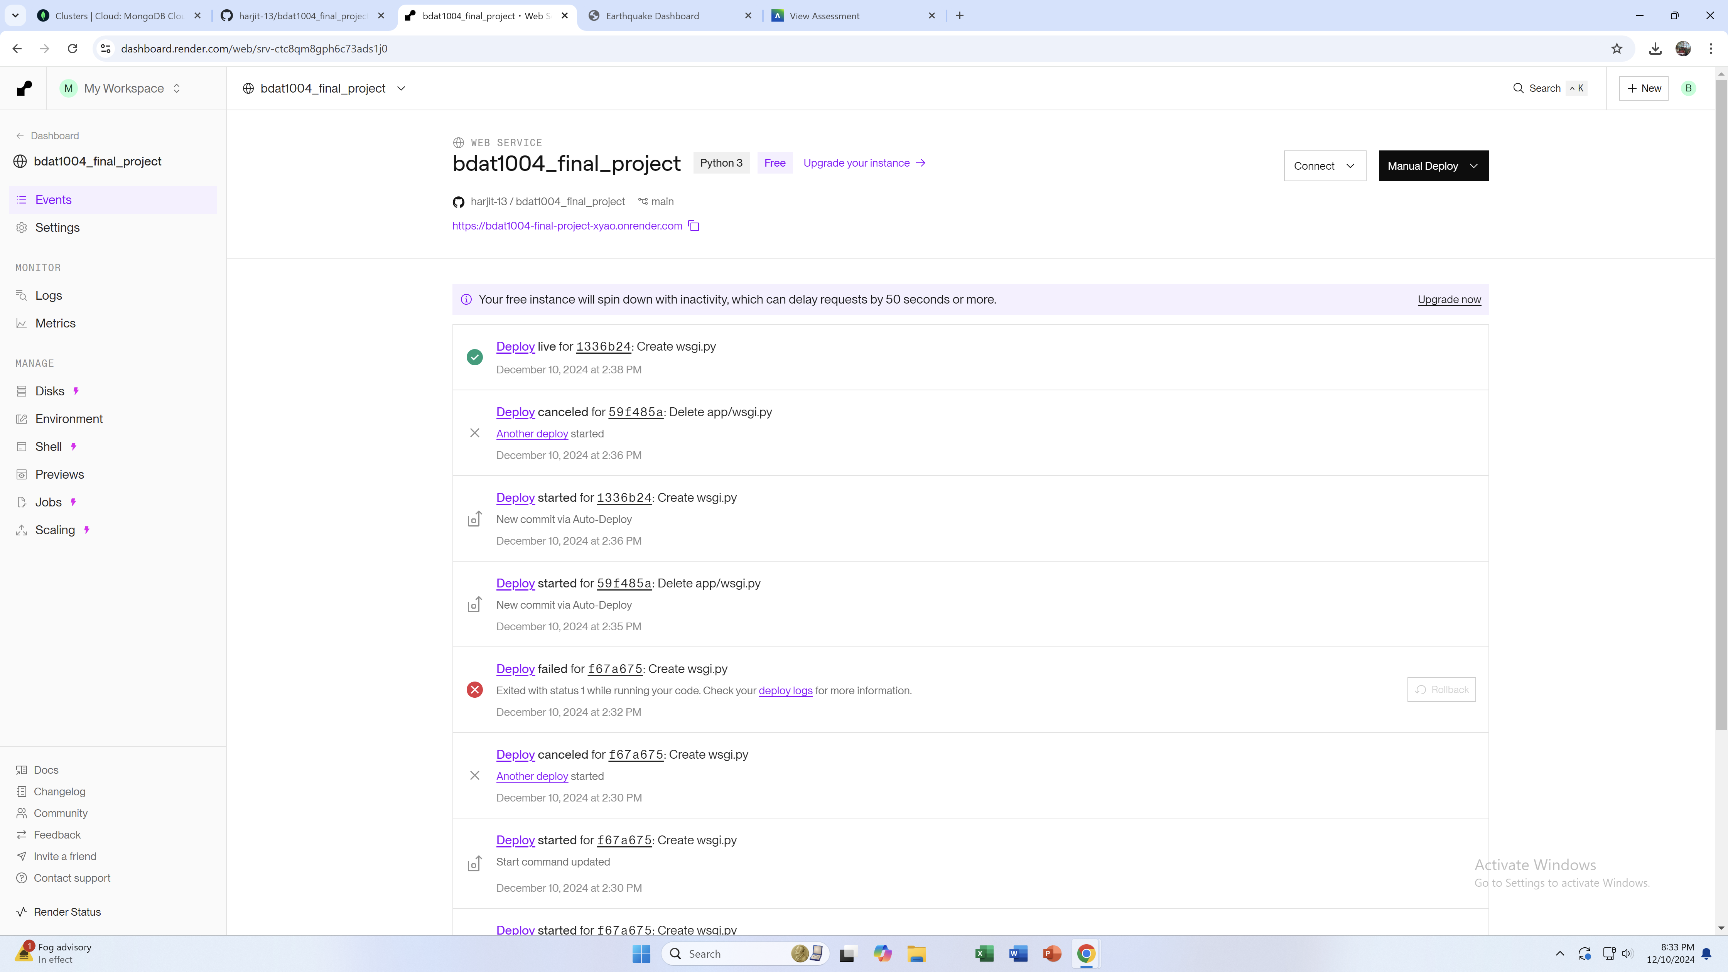
Why Render?
Free tier, simple setup, and reliable hosting.

Slide 20
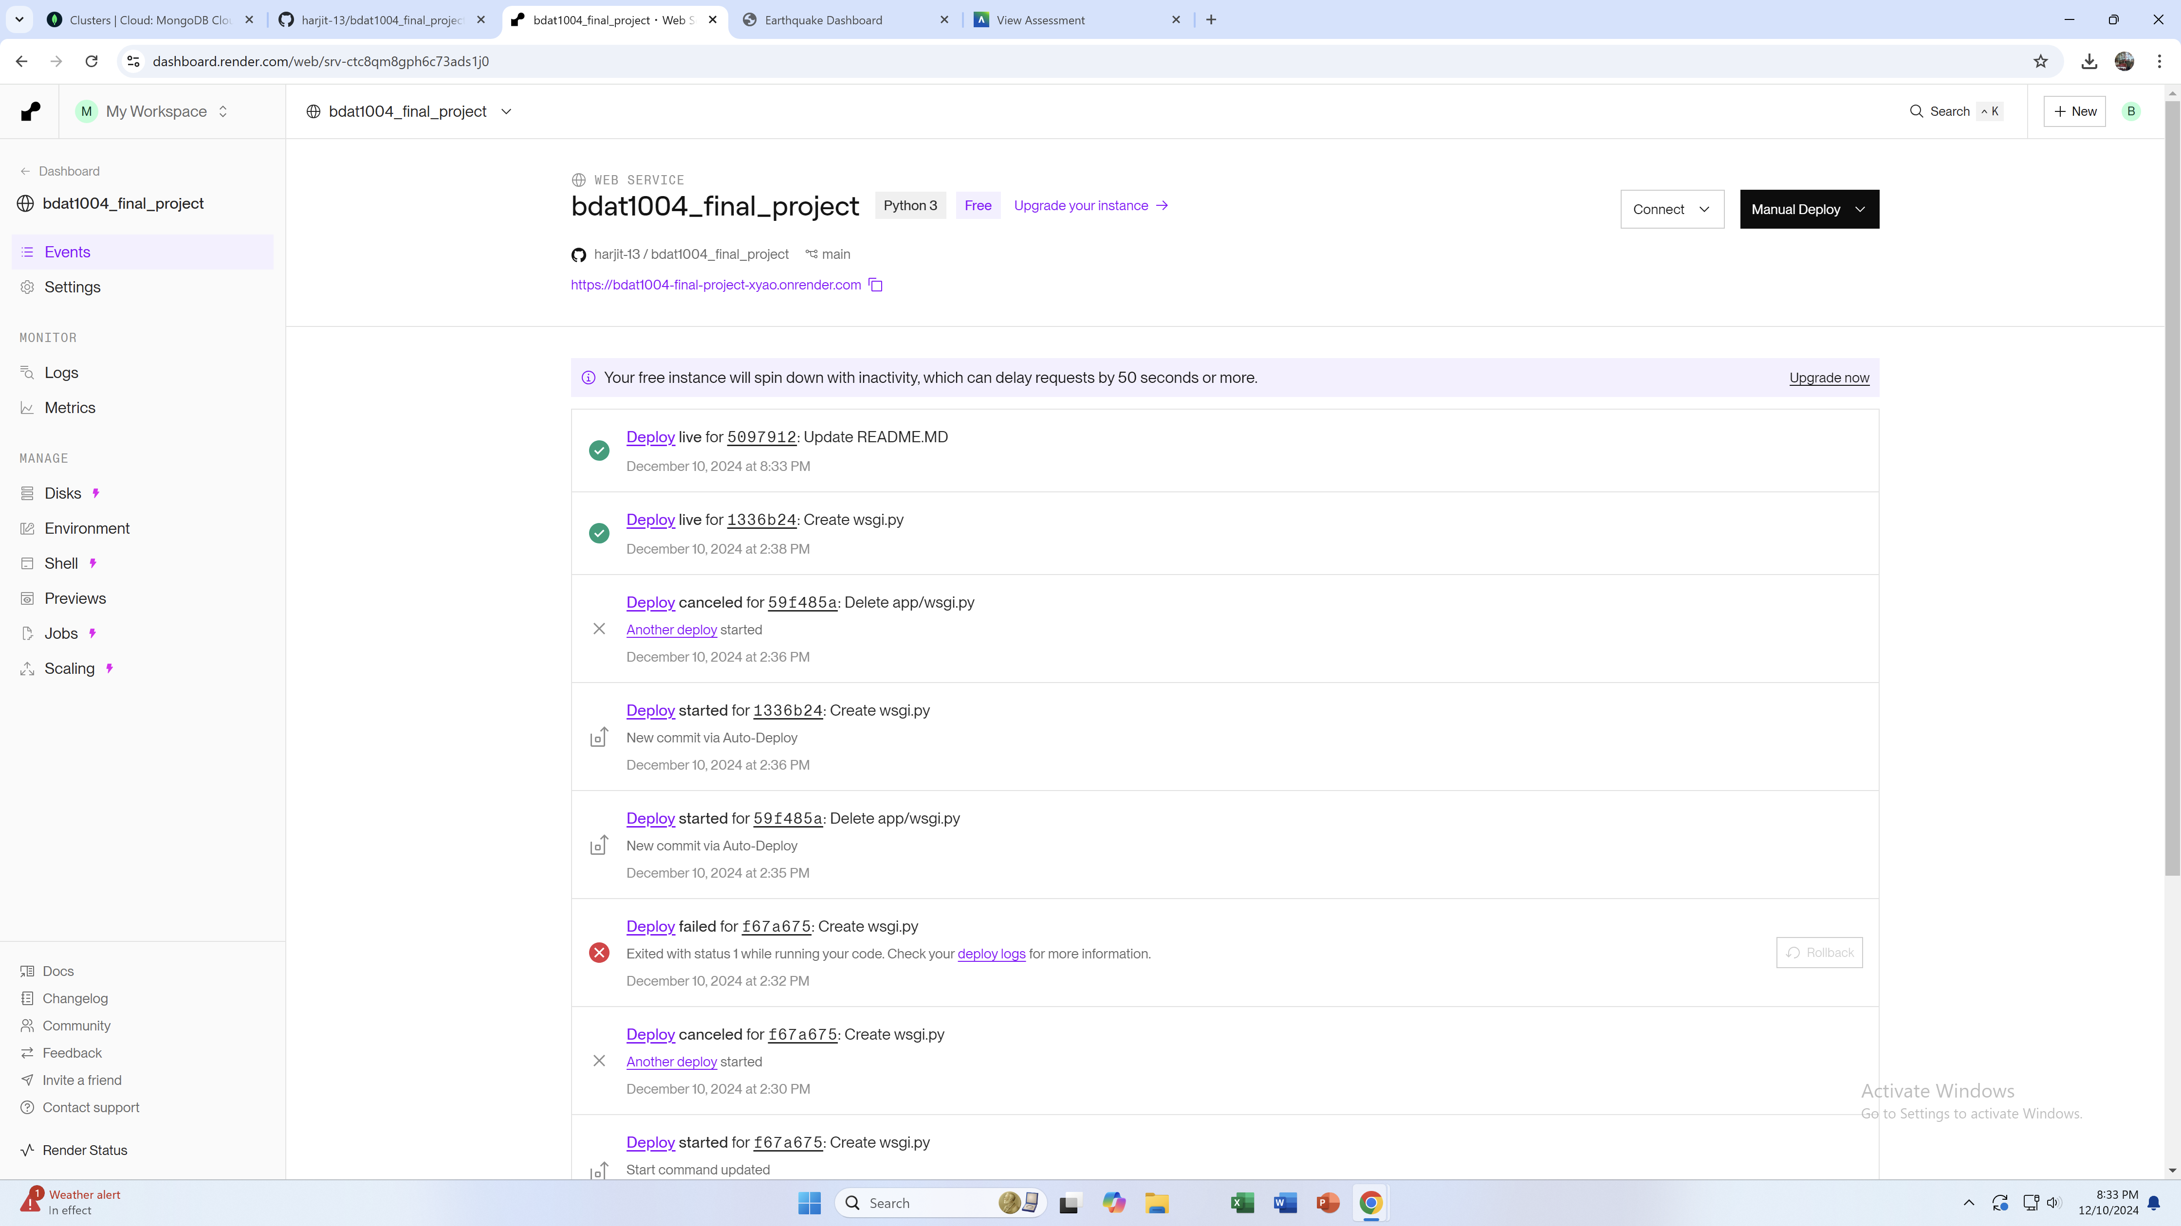

Slide 21
Deployment Process
Deployment Pipeline Diagram
1. Local Development:
Set up the Flask project structure.
Flask application is developed locally.
Tested locally using Gunicorn and a local MongoDB instance.
Data visualizations and batch processes are tested.

Slide 22
Stages
Local Development: Coding and testing the Flask app.
GitHub Repository: Code pushed to GitHub.
Render Deployment: Render pulls the code and deploys it.
Public URL Access: Application hosted on a publicly accessible Render URL.
MongoDB Atlas Database: Data storage and integration with the web app.

Slide 23
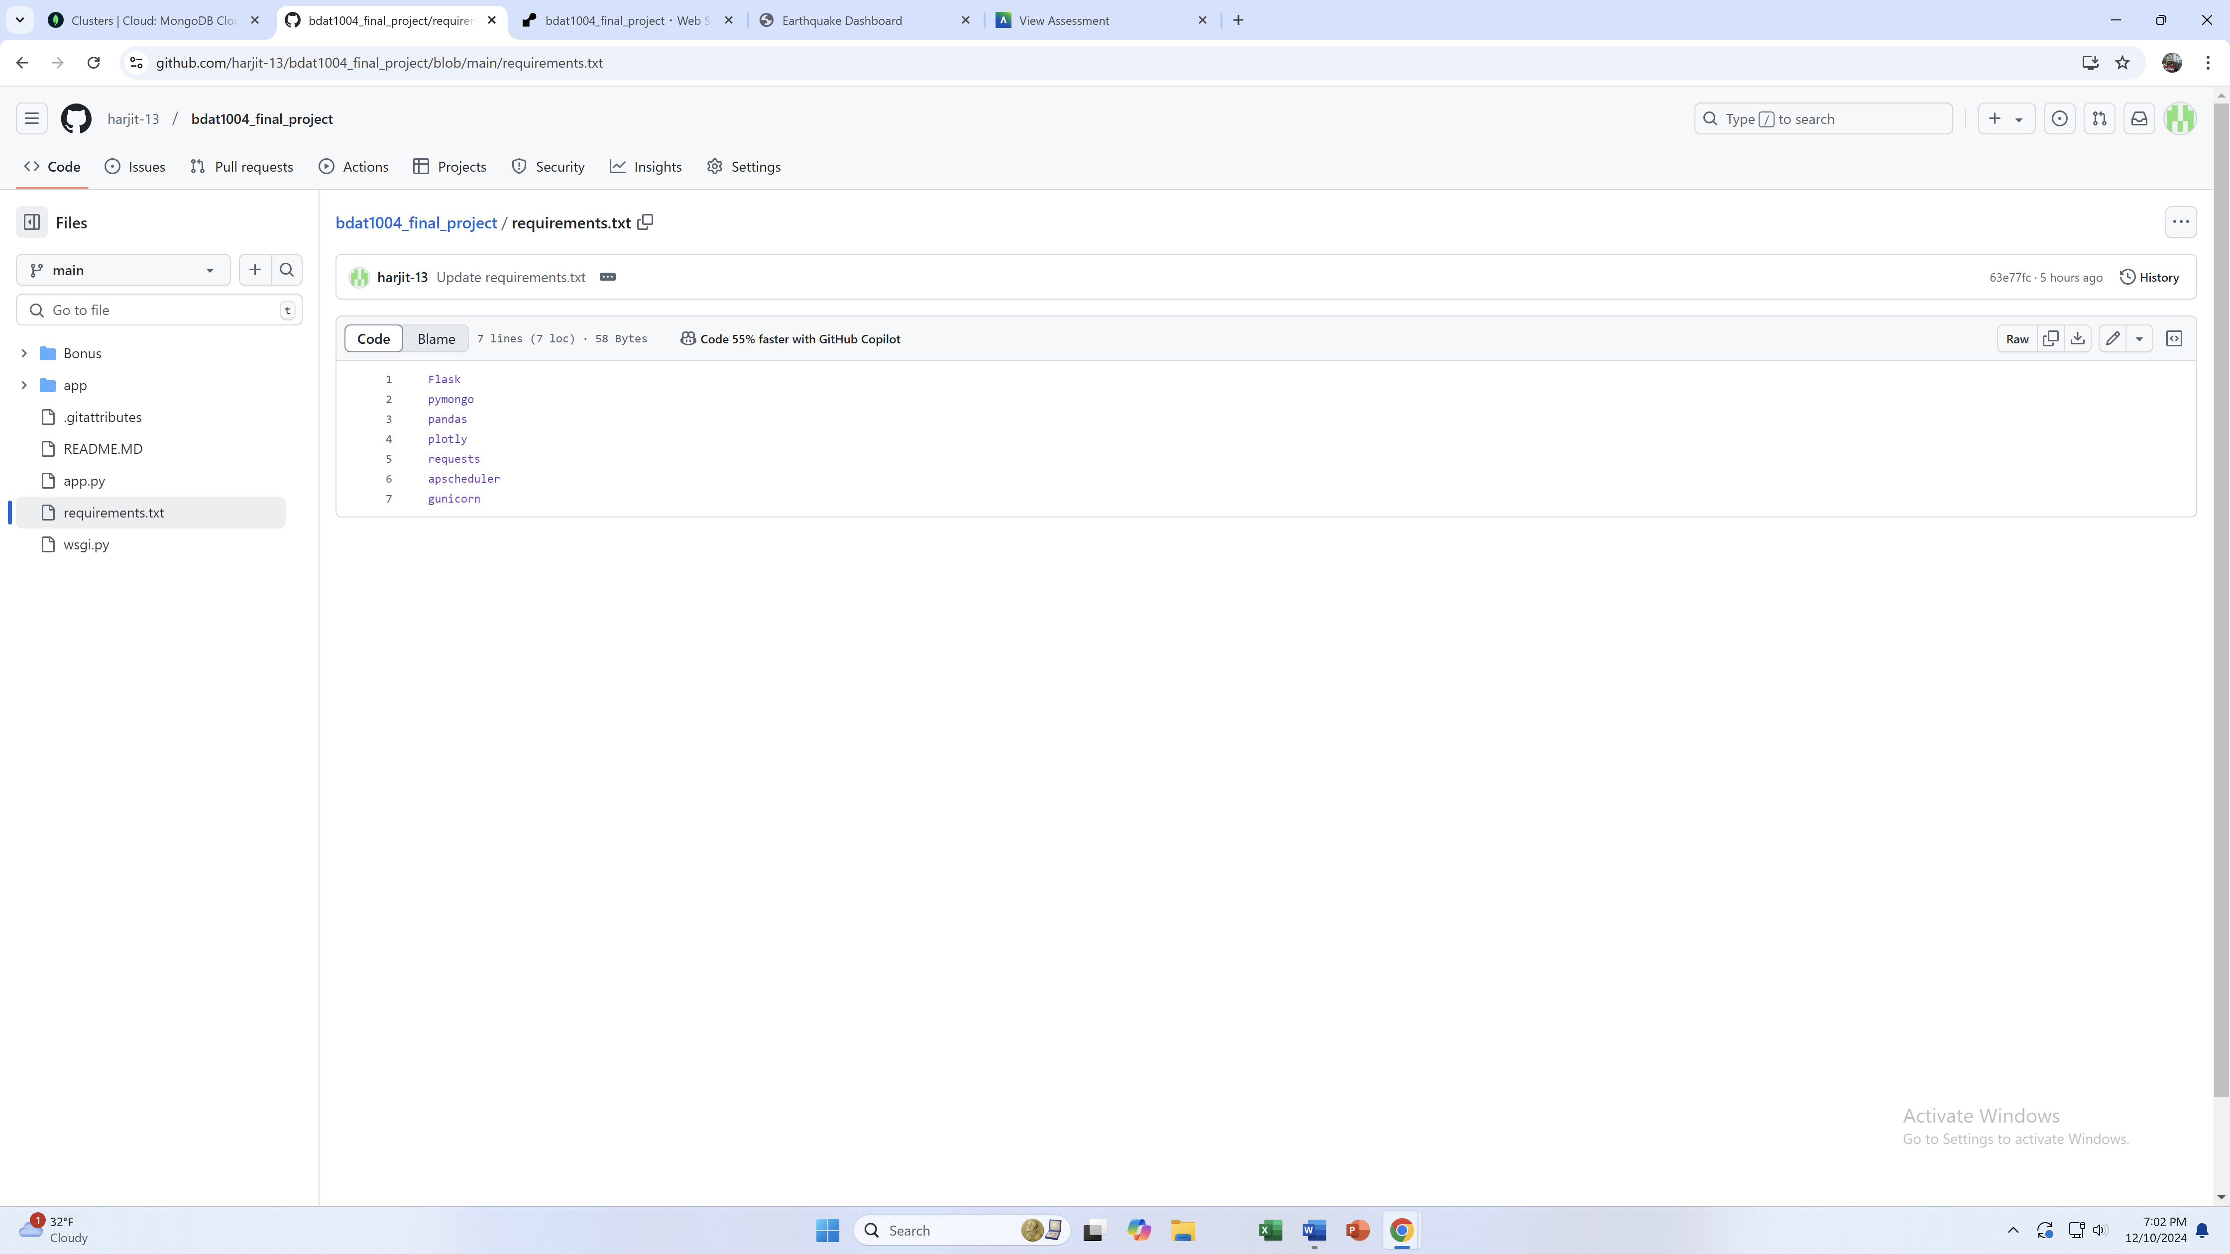
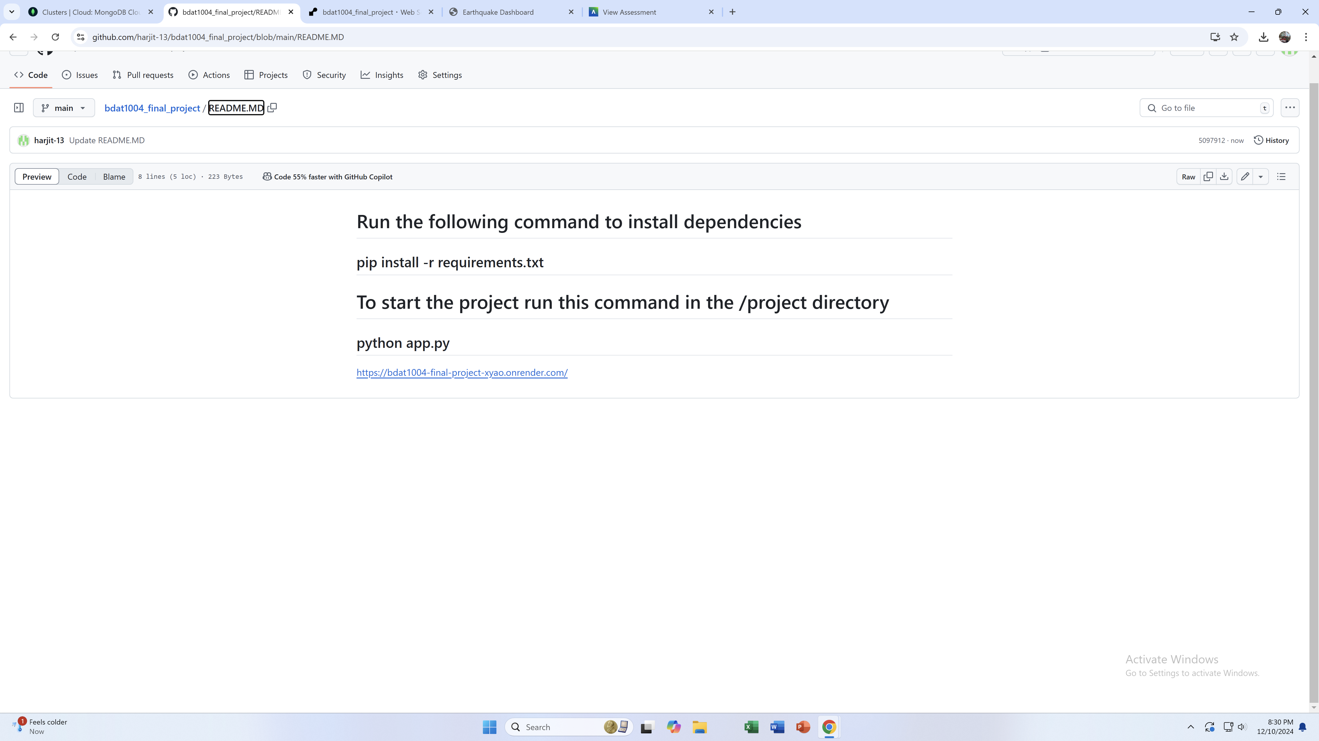
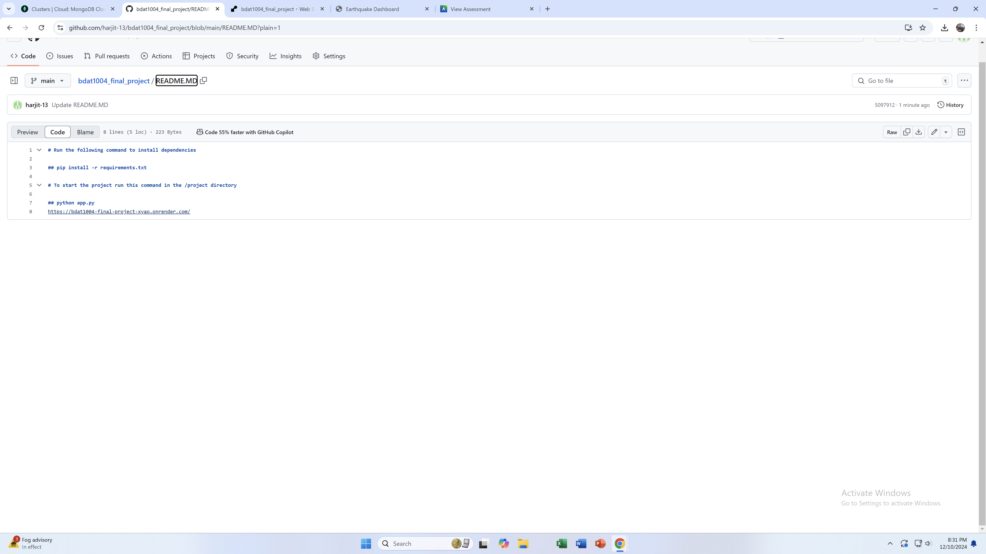
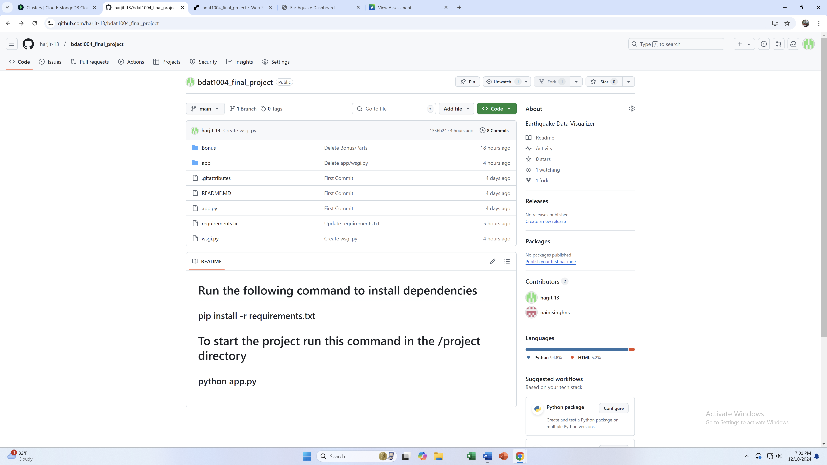
Push to GitHub:
The project (codebase) is pushed to a GitHub repository.

Slide 24
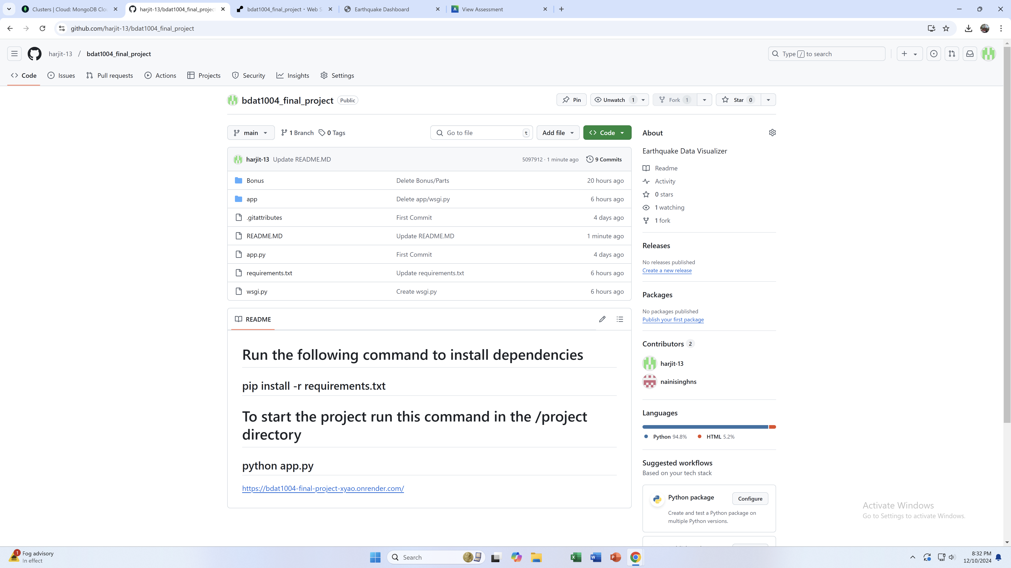
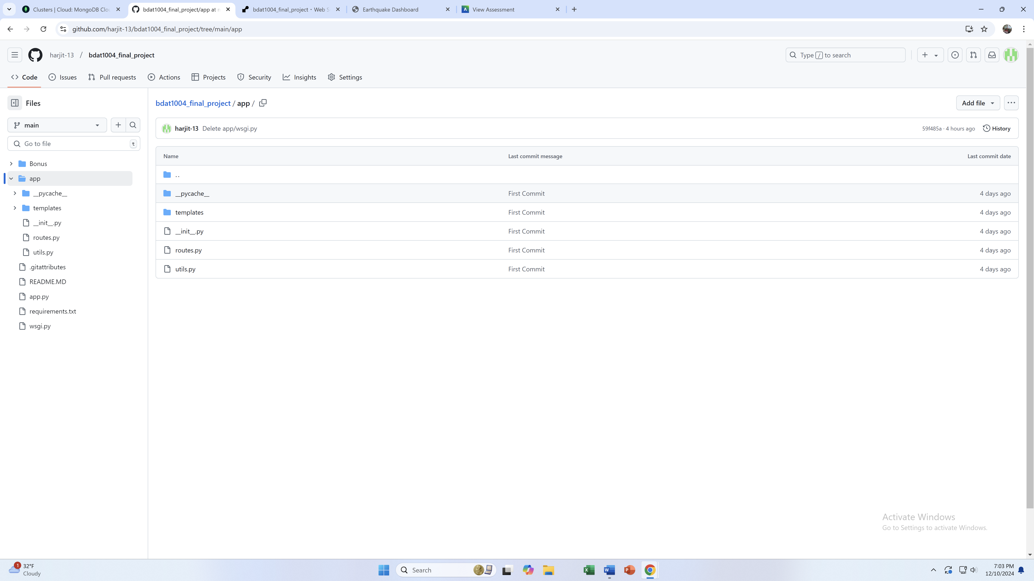

Slide 25

Cloud Deployment:
Render pulls the project from GitHub.
Dependencies (requirements.txt) are installed in a virtual environment.
Gunicorn is configured to serve the app.
App is deployed and publicly accessible via Render's URL.

Slide 26
Live Application:
Users can access the web application via a public URL.
Flask dynamically fetches data from MongoDB Atlas and renders it in the dashboard.

Slide 27

Leveraging WSGI for Efficient Deployment

Slide 28
WSGI
WSGI (Web Server Gateway Interface) is a standard interface between web servers and Python web applications.
It ensures that the server can handle HTTP requests and pass them to the Flask app efficiently.
Why ?
Flask’s built-in server is not production-ready.
WSGI, with tools like Gunicorn, provides: Scalability, Stability, & Compatibility with modern web servers like Nginx.

Slide 29
How We Used It:
Created a wsgi.py file to expose the Flask app instance (app).
Configured Gunicorn to act as the WSGI server and serve the app in a production-ready environment.
Deployed the app using Render with Gunicorn as the entry point.
Gunicorn---> Flask App (via WSGI)---> MongoDB / Frontend
While Flask has a built-in server for development, it’s not suited for production environments. WSGI provides a robust standard for serving Python applications.

Slide 30

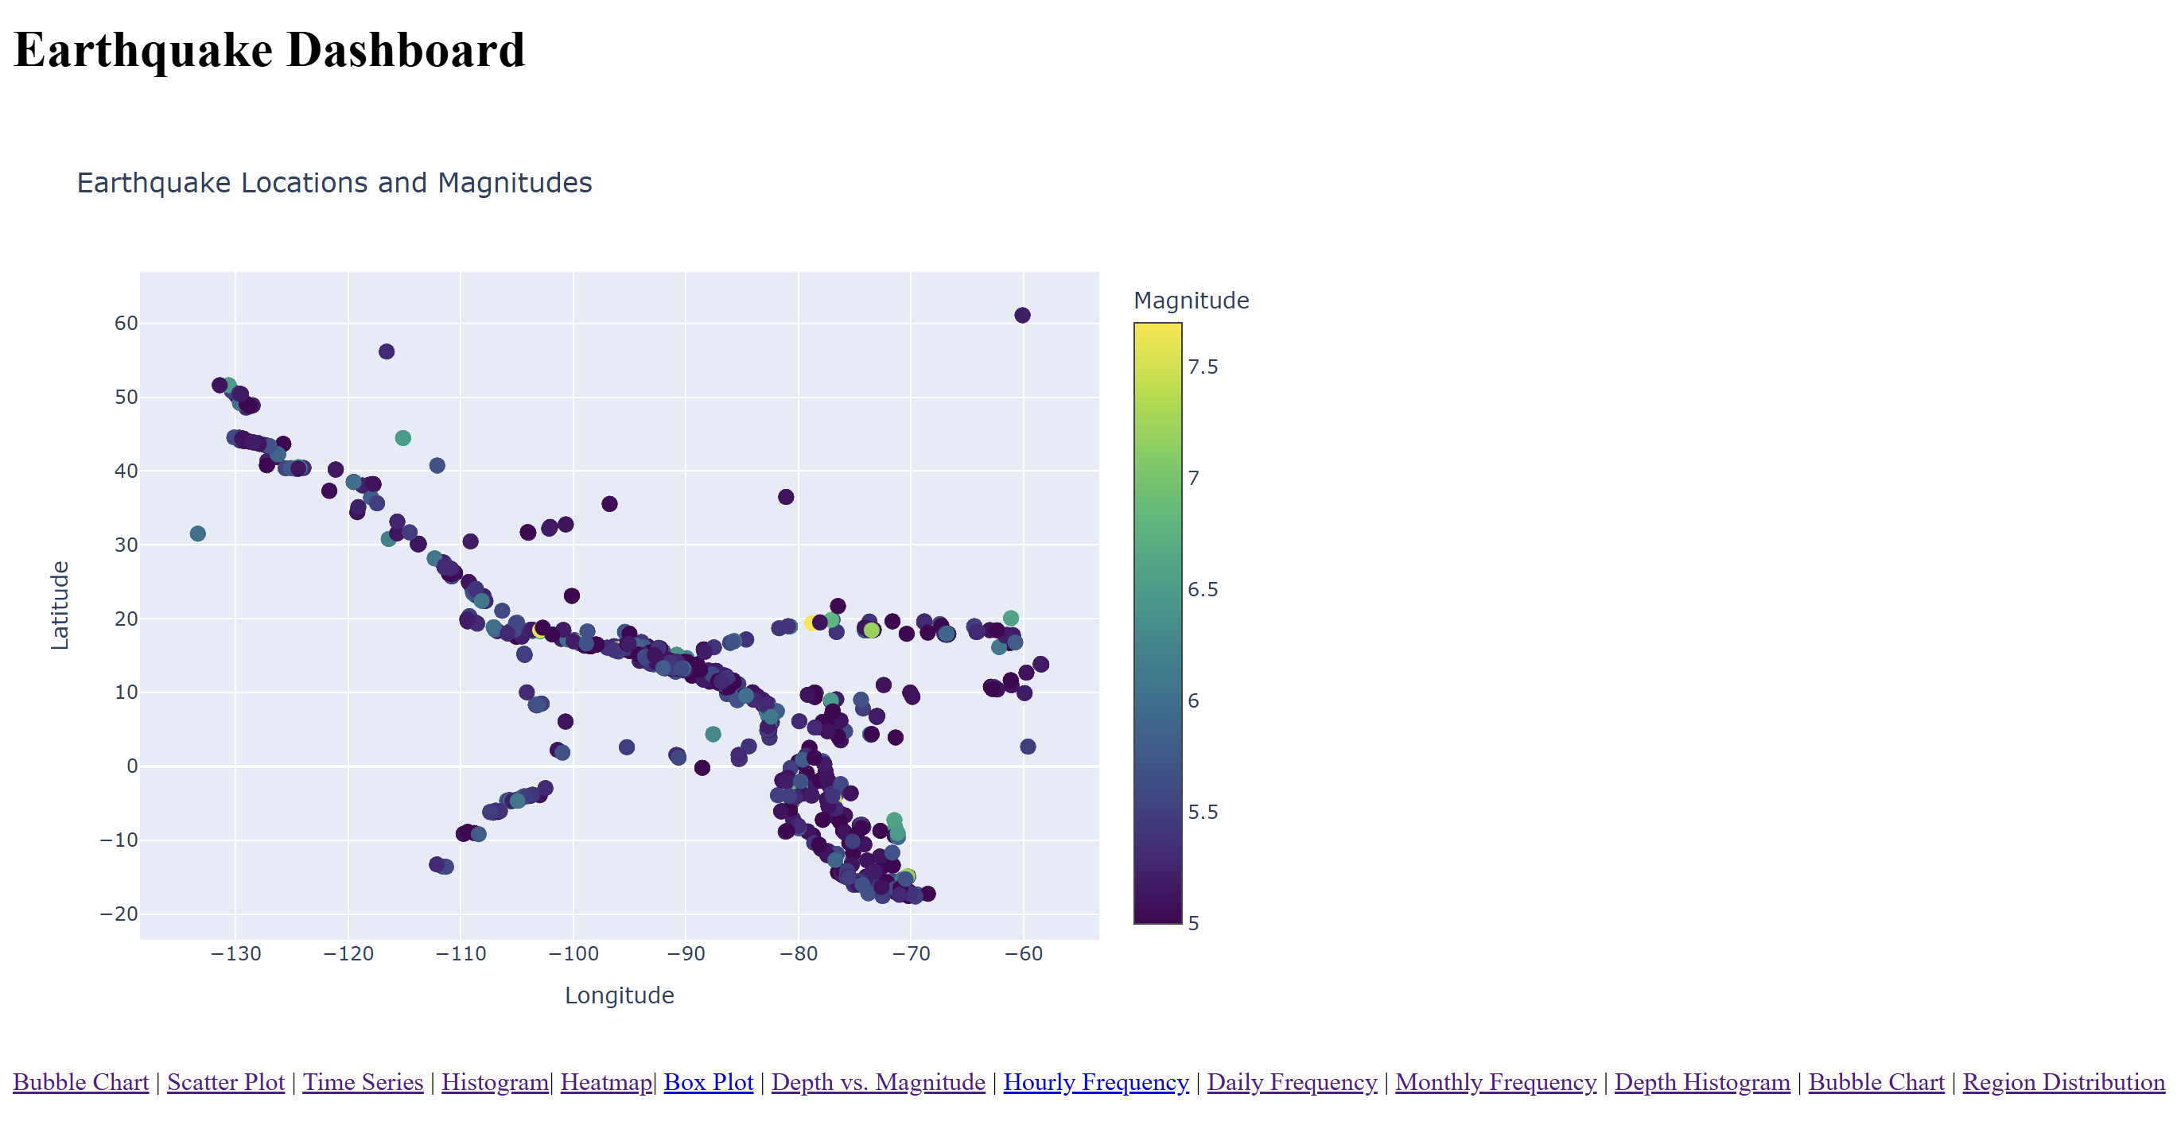
Our website https://bdat1004-final-project-xyao.onrender.com/ is the frontend interface of web application, which is built using Flask for the backend and Plotly/JavaScript for data visualizations. It allows users to interact with and view the earthquake data through charts and graphs directly in a web browser.

Slide 31
Homepage:
The landing page of application, typically accessible through the URL hosted on Render.
Displays key visualizations of earthquake data, such as:
Scatter Plots: Earthquake magnitudes vs. depth.
Heatmaps: Density of earthquakes by location.
Histograms: Distribution of earthquake magnitudes.

Slide 32
Backend Connection:
The website dynamically retrieves earthquake data stored in MongoDB Atlas.
Data is processed server-side and passed to the client for visualization.

Slide 33

Interactive Charts:
Built using Plotly, which allows users to hover, zoom, and interact with the graphs for better insights.

Slide 34
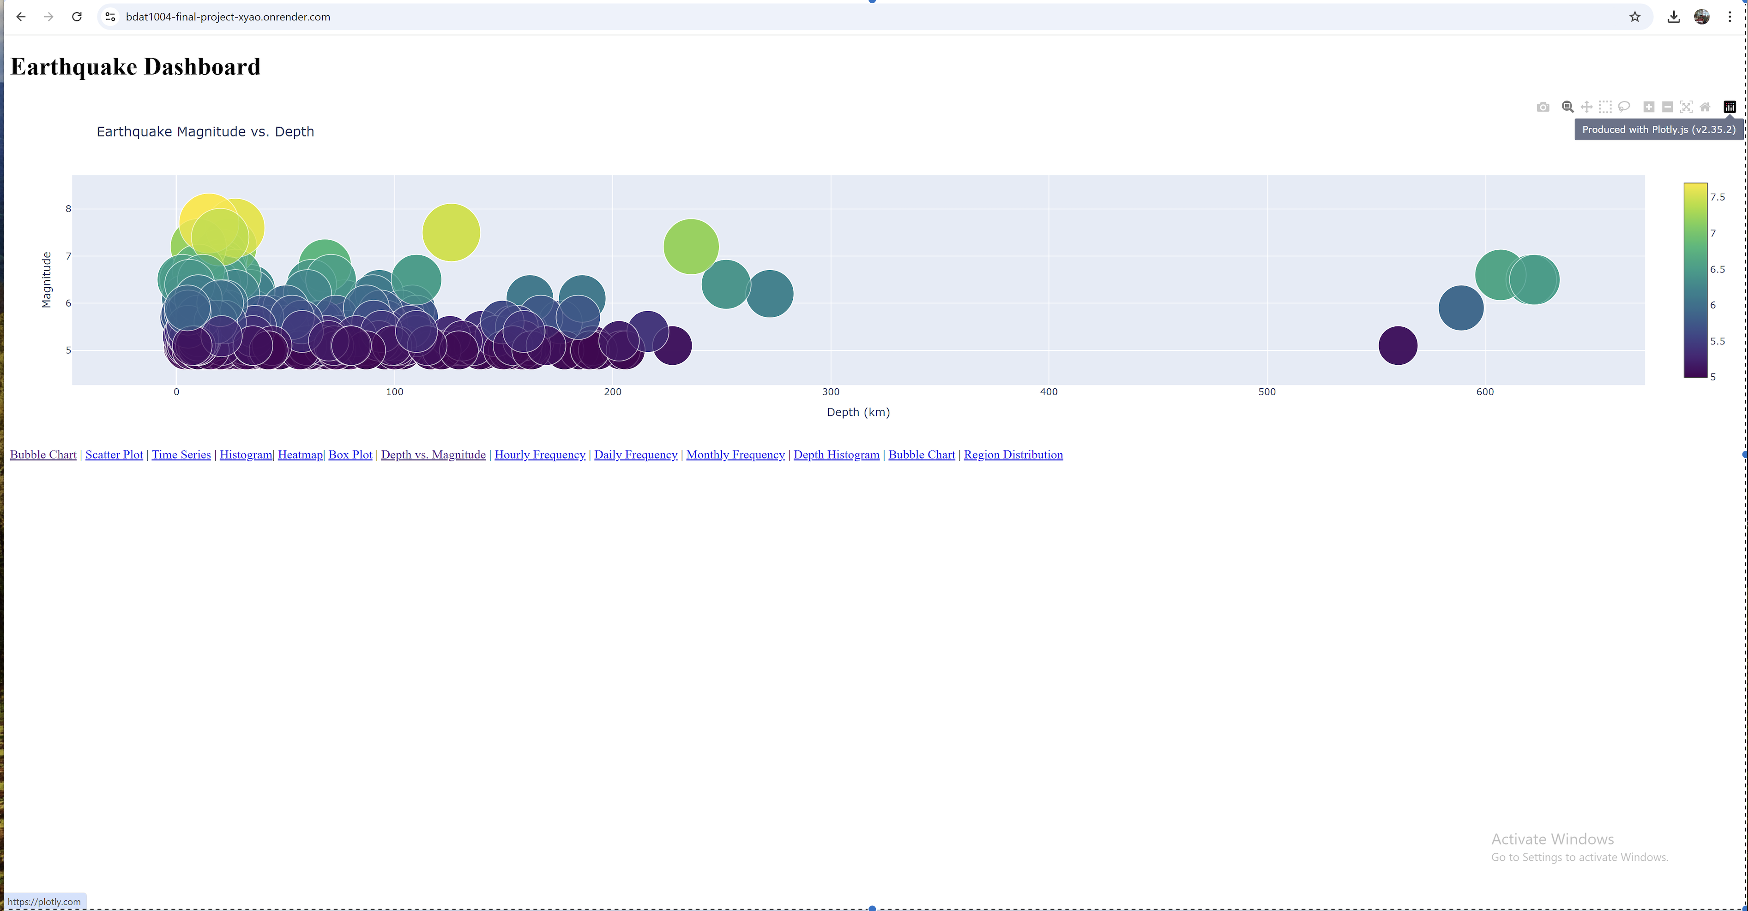

Slide 35
Hosted on Render:
The website is publicly accessible through a URL, enabling you to showcase it live to potential clients.

Slide 36

URL
https://bdat1004-final-project-xyao.onrender.com/

Slide 37


API Endpoint (Optional):
This app may expose an API endpoint (e.g., /api/data) to fetch raw earthquake data in JSON format.

Slide 38
Fit-Gap Analysis
Fit:
Demonstrates the ability to integrate data sources, databases, and web frameworks seamlessly.
Visualizes critical insights for decision-making.
Gaps:
Limited functionality in the prototype (e.g., user authentication).
Optimizations for performance can be explored in the full-scale project.

Slide 39
Fit-Gap Analysis
Strengths of the Prototype:
Data Integration: The prototype demonstrates a strong
ability to integrate diverse data sources, databases, and web frameworks.
Data Visualization: The prototype effectively visualizes
critical insights, providing valuable information for
decision-making.
Gap: Areas for Improvement
User Authentication: The prototype lacks a robust user
authentication system, which is essential for security and access control.
Performance Optimization: The prototype may require
optimization to ensure optimal performance, especially
when handling large datasets or complex queries.

Slide 40
Closing Remarks
This project demonstrates the integration of Flask,
Mongo DB Atlas, and dynamic data visualization
to create an interactive, real-time earthquake data
application. The application is now ready for
real-time data updates, interactive charts, and
location-based visualizations, enabling a seamless
and informative user experience.

